Slide 1
Presentation of GOBOARD
TgopKnight
Group 3

Slide 2
Logic model of group
Inputs:
Nand2Tetris Course
Outputs:
Almost Finish the interface of GOBOARD
Finish Project1、 2、3、4、5
Process:
GOBOARD by Tang Tianying
Project1、 2、3、4、5 by orther group menbers
Impacts:
As a basic of GO game
Understand whole Hack computer architecture

Slide 3
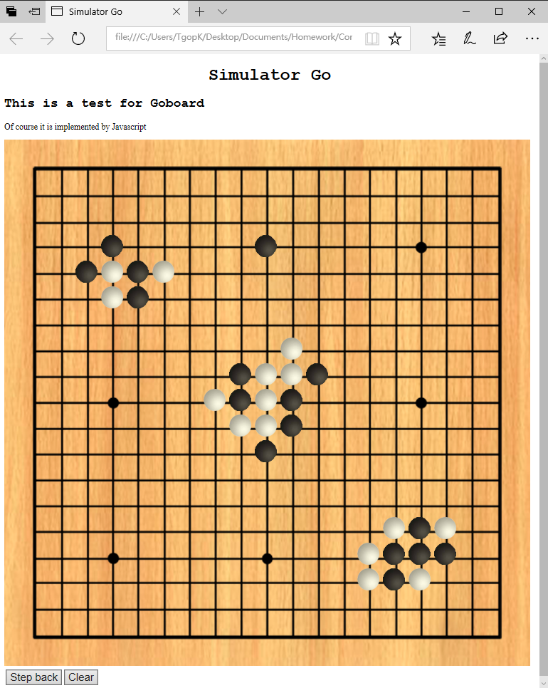
EFFECTION
Simulated on
Microsoft Edge

Slide 4
Logic model of goboard
Inputs:
Html/JavaScript Programming + Pictures of Goboard & Go piece
Recourse code from BitmapEditor
Activities:
Editor(Adobe Dreamweaver CC)
Programming
Outputs:
A board supports basic placing pieces operation
Outcomes/Impacts:
As a basic of GO game

Slide 5
What DO WE ACHIEVE
Simulator of a Goboard
Able to place Black and White Go piece
Able to judge placed point
Able to ‘Withdraw’
Able to ‘Clear’ the ‘Board’

Slide 6
HOW DO WE achieve
HTML/CSS
JavaScript
Adobe Dreamweaver CC

Slide 7
Build a board without chess pieces
Thanks the picture from network
(along with the black and white Go pieces)

Slide 8
PLACE A Chess piece
JAVA
Array: Grid[19][19]
-1: empty 0: black 1: white
Int: now = 0/1 (decide which Go piece next)
HTML
<img> + empty.png/black.png/white.png(41px*41px)
Set an id with every <img> (x * 19 + y)
<onclick>

Slide 9
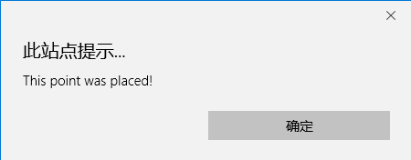
PLACE A Chess piece
With Array Grid, we can simply finish judging if a location was already place with a Go piece
Wait a second
19*19=361
361 <img> will rapidly increase the size of code!
Document.getElementById() + innerHTML
Using JavaScript to write HTML code!

Slide 10
Withdraw
JAVA
Data Structure: Stack
Needn’t record placed color
Document.getElementById()
HTML
<button>

Slide 11
CLEAR
JAVA
Reinitialize the code
HTML
<button>

Slide 12
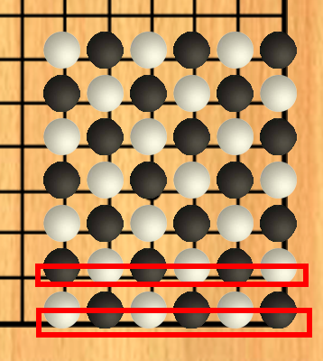
OuR PRoblems
For each chess piece: <style=“location:absolute”>
With different explorer, there might be some deviation with Go pieces on board
Such as Google Chrome

Slide 13
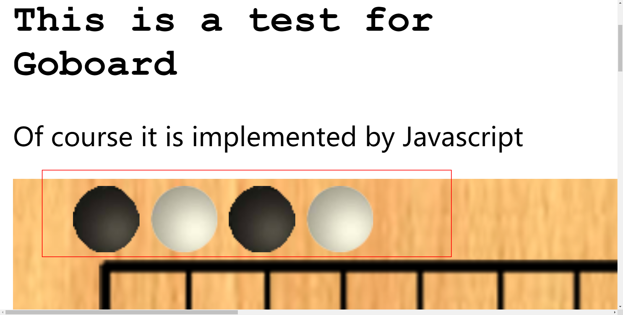
OuR PRoblems
STILL: <style=“location:absolute”>
When zoom in, there might be some deviation with Go pieces on board
Problem happens when words above auto linefeed

Slide 14
SOLUTION
Q1: Redraw a Goboard!
Q2:
cut the Goboard and link them with corresponding Go pieces
Or we may use <table> <tr> <td>

Slide 15
Why not use jack
How does Jack work?
From project 1 to 8
Most difficult question: It works too slow……
Solution? Optimizing all operations from project 1 to 8
Artificial Intelligence? (Alpha Go Zero)
Question: How can you prove your solutions is the best?
How to defeat the solutions produced by AI?

Slide 16
Thanks for listening!

